Slide 1


Microsoft Power BI Module 2 – Data Extraction

Slide 2
Agenda
Overview of power bi desktop
Data sources in Power BI
Using Files as a Data Source
Using Database as a Data Source
Updating Files in Power Bl
Using SaaS Connectors
09
11
Other Data sources
R Script
Areas in Power Query Editor
Python Script
Power Query and editor
Advanced Editor

Slide 3
Overview of Power BI Desktop

Slide 4
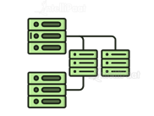
Overview of Power BI Desktop
Power Bl Desktop features a workspace for creating reports and comprises three key views in which we can work.
Report view Data View Model View

Slide 5

Overview of Power BI Desktop
Report view
Data View
Model View
This is the main workspace where we add report items, such as bar charts, maps, and Pie charts, and display data using these report items

Slide 6
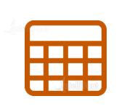
Overview of Power BI Desktop
Report view
Data View
Model View
The data view is used to see imported datasets, in addition to shaping the data using transformations and M expressions.

Slide 7
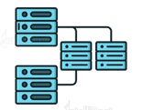
Overview of Power BI Desktop
Report view
Data View
Model View
Power Bl has an autodetect relationships feature, and we can also manually and set relationship properties.

Slide 9
Data Sources in Power Bl

Slide 10




Data Sources in Power Bl
In Power Bl Desktop, we have a Wide choice of sources to import data
from, including database, file, Azure, and SaaS connectors.
Database Connectors File Connectors Azure Connectors SaaS Connectors

Slide 11
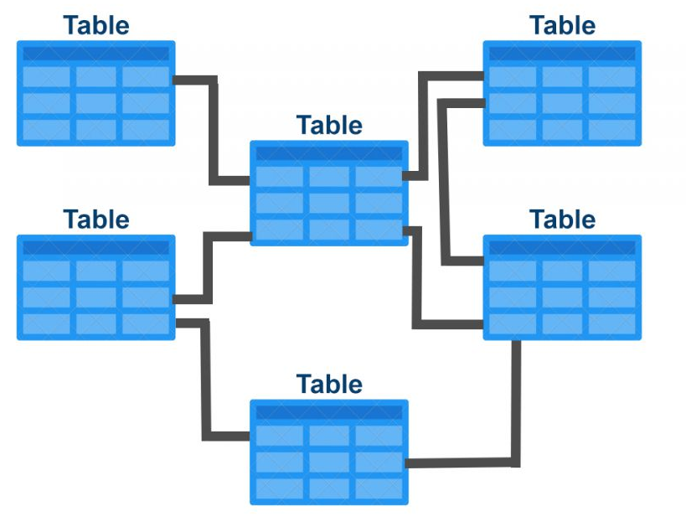
Data Sources in Power Bl
Data Sources
Database Connectors
File Connectors
Azure Connectors
SaaS Connectors
Power Bl supports the database connections for importing data from on-premises sources.
Database connectors include:
MySQL
SQL Server
Oracle
IBM Db2
Teradata

Slide 12

Data Sources in Power Bl
Data Sources
Database Connectors
File Connectors
Azure Connectors
SaaS Connectors
Using a file connector, we can import either a single file or a folder to select multiple files. This is useful when we have a folder location used to store files created on a schedule.
File connectors include:
CSV
Text
XML
JSON
MS Excel

Slide 13
Data Sources in Power Bl
Data Sources
Database Connectors
File Connectors
Azure Connectors
SaaS Connectors
Using Azure connectors in Power Bly we can connect to the database in the Azure cloud
Azure connectors include:
Azure SQL Data Warehouse
Azure Blob Storage
Azure Table Storage
Azure SQL Database
Azure Cosmos DB
Azure SSAS

Slide 14
Data Sources in Power Bl
Data Sources
Database Connectors
File Connectors
Azure Connectors
SaaS Connectors
Power Bl Desktop makes it easy to connect to external SaaS applications for analyzing data related to fields such as sales, marketing, finance and social media.
SAAS connectors include:
Salesforce
GitHub
Facebook
Amazon
Google Analytics

Slide 15
Using Excel as a Data Source

Slide 16

Using Excel as a Data Source
In Power BI, we can connect to files from Power Bl Desktop or from Power Bl Service.
When we import data directly into Power Bl Service, the maximum file size should be 250 MB
Using Power Bl, we can also connect to various file formats, folders, etc. and even import Power BI Report files with the .pbix extension

Slide 17


Using Excel as a Data Source
There are two approaches in extracting an Excel file as a Data Source:
Connect to an Excel workbook and use its contents as a dataset for Power Bl reports and dashboards. We can edit our data using Power Query Editor
Import a whole Excel workbook and explore it in the same way we would do when using Excel Online, but here we cannot edit our data.

Slide 18
Using Excel as a Data Source
Click on Get Data
Different data sources appears
Click on Files
Select the file format of our choice

Slide 19
Demo: Importing Data from Excel

Slide 20
Updating Files in Power Bl

Slide 21

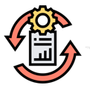
Updating Files in Power Bl
Uploading a File
This applies to CSV, Power BI Desktop files, and Excel.
We upload a local file to Power Bl to build reports and dashboards; then, we make changes to the file and upload it again, providing the file name as the same, and then Power Bl will update the file
Data Refresh
Data Refresh in Power Bl works based on the subscription types and on the data sources.
For free users, data can be refreshed daily with a
maximum of 10,000 rows/hour.
For pro users, data can be refreshed hourly up to 1 million rows/hour

Slide 22
Using a Database as a Data Source

Slide 23

Using a Database as a Data Source
Microsoft SQL Server is one of the database sources available in Power Bl, which is a popular relational database management system (RDBMS)
It can handle multiple user connections and a high volume of data transactions, and it can run both in the cloud and on-premises
The steps for connecting SQL Server to Power Bl is the same as connecting other databases such as Oracle, MySQL, or IBM Db2

Slide 24
Using a Database as a Data Source
Power Bl Desktop Get Data
Click on SQL Server Database
Enter the server name and the database name
Use a query or select tables and views
Load into Power Query Editor or directly into a data model

Slide 25
Demo: Importing Data from SQL Server

Slide 26
Using SaaS Connectors

Slide 27

Using SaaS Connectors
From Power Bl Desktop, we can import data from third-party online solutions and combine the data in reports and dashboards
For example, we can create a report from Facebook that shows marketing data combined with the sales data that is from Salesforce

Slide 28
Other Data Sources

Slide 29



Other Data Sources
Python Script web R Script Connector
OData Feed SharePoint

Slide 30
Python Script

Slide 31

Python Script
We can directly run Python scripts in Power Bl Desktop by importing the datasets into the Power Bl data model and adding visualizations to them
To run Python scripts in Power Bl Desktop, install Python and the required Python packages.
In Power Bl Desktop, enable Python scripting .
Run our Python script and import data from Power Bl Desktop Get data > Others > Python Script.
Click on Connect; copy the Python script to the Python script dialog box, and click on 0K.

Slide 32

Python Script
We can directly run Python scripts in Power Bl Desktop by importing the datasets into the Power Bl data model and adding visualizations to them
Python can also be used for data cleansing, performing advanced data shaping, analytics, etc. in Power Bl Query Editor
We can also use an external Python IDE to create Python scripts and use those scripts in Power BI Desktop
We can also create Python visuals in Power Bl Desktop

Slide 33
R Script

Slide 34

R Script
The R programming language has been integrated with the Transact-SQL language that helps Data Scientists develop applications in R and deploy them in a SQL Server production environment
To integrate R and SQL, a service was introduced known as SQL Server R Services
This service helps us run R scripts, create data models, and import results to Power Bl Desktop

Slide 35
Power Query

Slide 36
Power Query
Power Query is an engine for data transformation and preparation.
01 Highly interactive for rapidly and iteratively creating queries over any data source, of any size
02 Power Query has a graphical interface for obtaining data from data sources as well as a Power Query Editor or performing transformations
03 Extraction and transformation of data can be performed using power query

Slide 37
Query Parameters

Slide 38
Query Parameters
Users can simply make sections of reports and data models dependent on one or more parameter values using query parameters.
01By including Query Parameters in a report, the user can make the report's elements rely on the parameters they've created.
02Parameters allow you to change the output of the queries dynamically depending on their value.
03 Model authors can use Dynamic M Query Parameters to allow report viewers to set the value(s) for a M Query Parameter using filters or slicers, which can be extremelyhandy for query performance optimizations

Slide 39
Power Query M

Slide 40
Power Query M
Power query is all about connecting to several data sources and "mashing" them, the M stands for data mash-up. M iS a functional language, which means it is mostly comprised u of functions that are invoked to evaluate and give results. Power Query M function has over 700 functions. Some of the functions are listed below.
Functions by Category
List functions
Table functions
DateTime functions
Logical functions
Uses
Create and manipulate list values
Create and manipulate table values
Create and manipulate table values
Create and manipulate logical values
Example
List.Count, List.Distinct,
List.Combine, List.SumItemExpression.From, Table.ToList, Table.ColumnDateTime.Date, DateTime.From,DateTime. FromTextLogical.From, Logical. From text

Slide 41
Power Query Editor

Slide 42
Power Query Editor
Power Query Editor helps us load data from a wide number of data sources and apply transformations on it
Transform Data
Merge Data
Load Data
Shape Data
Format Data

Slide 43
Components of Power Query Editor

Slide 44
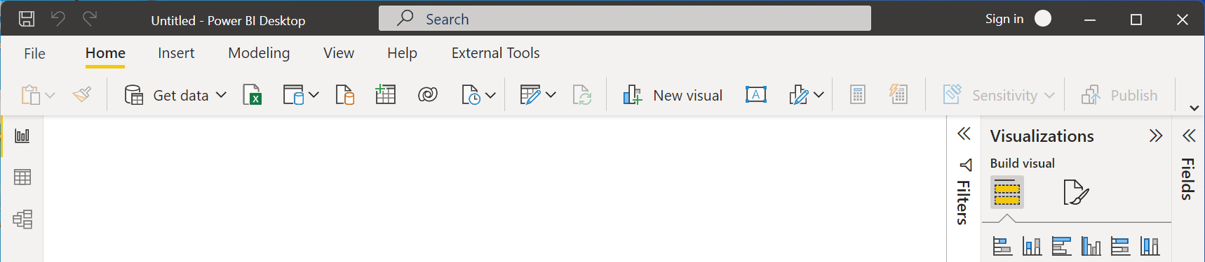
Components of Power Query Editor
Ribbon
The ribbon in Power Query Editor has six tabs:
Home
Transform
Add Column
View
Tools
Help
01Ribbon
02Queries Pane
03Current view
04Query Settings
05Status Bar

Slide 45
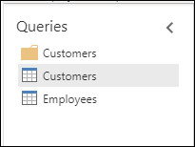
Components of Power Query Editor
Queries Pane
The Queries pane will show the active queries and their names.
When we select a query from this pane, data will be displayed
on the current view pane
01Ribbon
02Queries Pane
03Current view
04Query Settings
05Status Bar

Slide 46
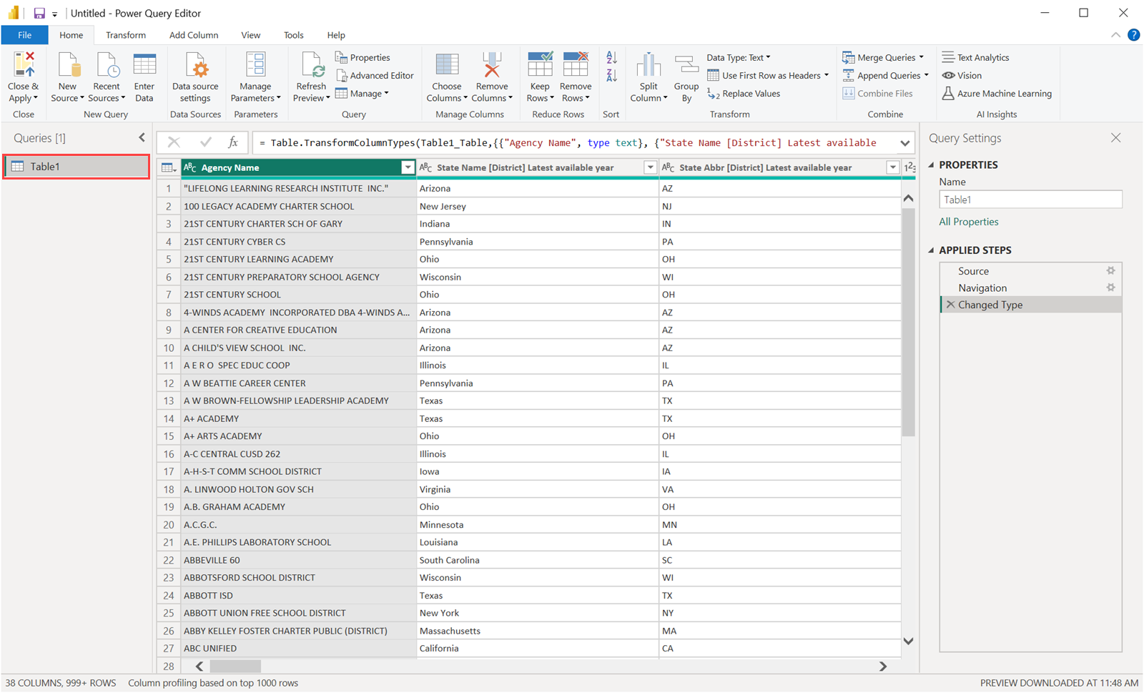
Components of Power Query Editor
Current view
In this pane, the data from the selected query is displayed where we can shape, transform, or merge the data to meet our needs
01Ribbon
02Queries Pane
03Current view
04Query Settings
05Status Bar

Slide 47
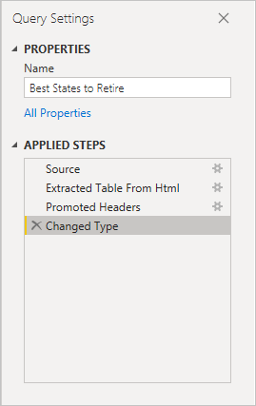
Components of Power Query Editor
Query Settings
This pane shows the steps associated with a query. All the operations that we perform on the data are captured by APPLIED STEPS in the Query Settings pane
01Ribbon
02Queries Pane
03Current view
04Query Settings
05Status Bar

Slide 48
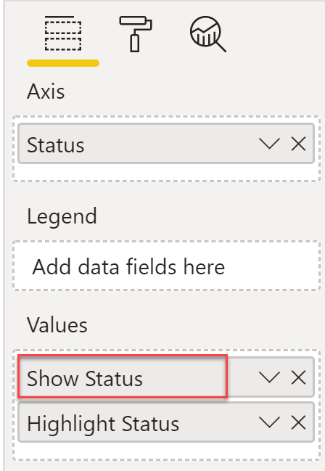
Components of Power Query Editor
Status Bar
A bar that shows important details about the query, including as execution time, total columns and rows, and processing status. This bar also has buttons that allow you to change your current view.
01Ribbon
02Queries Pane
03Current view
04Query Settings
05Status Bar

Slide 49
Advanced Editor

Slide 50
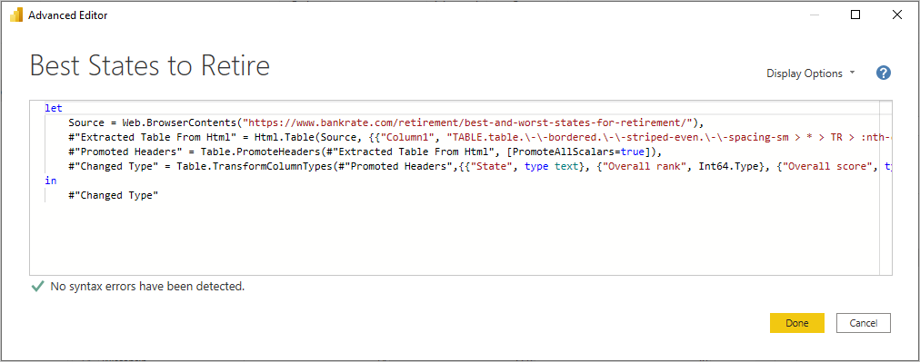
Advanced Editor
Using Advanced Editor, we can see the code that Power Query Editor uses
with each step, and we can also create our own code
To launch Advanced Editor, go to View > Advanced Editor

Slide 51
Demo: Overview of Query Editor

